Slide 1
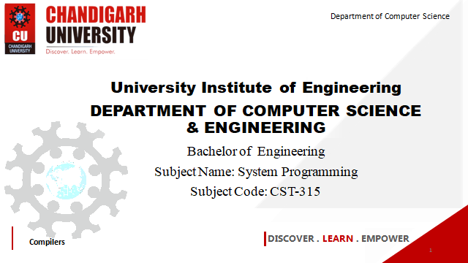


Department of Computer Science
University Institute of Engineering
DEPARTMENT OF COMPUTER SCIENCE & ENGINEERING
Bachelor of Engineering
Subject Name: System Programming
Subject Code: CST-281
Compilers
DISCOVER . LEARN . EMPOWER

Slide 2
Chapter-1.1 Overview of System Software
Department of computer Science
Recent Trends in Software Development
Levels of System Software

Slide 3
Recent Trends in Software Development
In the recent past, IoT, data management, and digitalization of services are some aspects that software has penetrated. It has become difficult for developers and businesses to keep up with these trends. It has become crucial to understand the upcoming trends that will help you modify your business model accordingly.
The latest software development trends in 2022.
Progressive Web Apps
A Progressive Web Application (PWA) can be accessible offline by using the previously cached data of your interactions with the app. This web application provides a seamless user experience to native mobile app and web application users.
DevOps
DevOps has become one of the best practices in the software landscape. It is the combination of operations and development that removes the barrier between the operations and the development process. The main task of DevOps is to unify the entire software application lifecycle, including development, testing, deployment, and operations.

Slide 4
Recent Trends in Software Development
Cyber Security
In the current era, it has become crucial more than ever to build a safe and secure digital environment. Every business has digital assets in this modern age, so implementing the latest cyber security measures is necessary.
Cyber security has become one of the major software development trends to help companies strengthen their online security against potential attacks.
Internet of Behavior (IOB)
IOB is a data collection process based on the behavior and interests of internet users. The top companies like Facebook and Google have incorporated IOB-based data in their services to personalize search engine results and advertising targeting. It has helped businesses to create a personalized experience and channel their efforts in the right direction.

Slide 5
Recent Trends in Software Development
Low-code Development
Low-code development allows companies to create apps with minimum effort as minimal coding is required. Drag-and-drop website builders have already reformed the web development landscape, which will also impact software development.
Python
Recently, Python has become one of the most popular and fast-growing programming languages. Software developers widely use it to create complex web applications to fulfil the needs of modern-day businesses and customers.

Slide 6
Recent Trends in Software Development
Cloud-Native Apps
Cloud-native apps are also expected to become the fast-growing software development trend of 2022. It allows developers to build robust and highly-functional cloud-native apps more efficiently. One of the major benefits of a cloud-native app is that you can build it using many frameworks.
Whether you are a business owner or software developer, embracing the latest software development trends is a must. You need to stay updated on the software industry’s current trends so you can implement those practices accordingly.

Slide 7
Levels of System Software
System software is a set of programs that handles all the basic internal working of a computer.
Levels of System Software are
1. Operating System
An operating system is system software that controls the working of computer hardware and software. Moreover, it acts as a common connection between the computer hardware and software. In other words, we can also call it an interface between the hardware and the users.

Slide 8
Levels of System Software
Some important tasks performed by the operating system are:
Scheduling
Memory Management
File Management
Security
Protects data and other software from unauthorized access .
2. Language Processors
It is a special type of system software that converts the source code into machine code. The input given has to be in object code only hence, we use language processors. Also, the machine code executes faster as compared to the source code.
Source Code
Object Code

Slide 9
Levels of System Software
Different Types of Language Processors are:
Assembler It converts assembly language to machine language.
Interpreter It is a type of system software that executes the program line by line.
Compiler It is also a type of system software that executes the whole program at once.
3. Utility Software
Application Software
System Utilities
These types of system software are used for the proper and smooth functioning of the
computer system. They perform functions like removing outdated files, recover data which
is accidentally lost, finding information, arranging data and files in an orderly manner,
compress disk drive, install and uninstall programs, etc.

Slide 10
Levels of System Software
Different types of utility software are:
1. Antivirus Software They are used to protect the system from viruses. Some examples are Quick Heal, McAfee, etc.
2. Compression Tools They help compress large files. The files can be changed to the original form when we require it. Examples are WinRAR, PeaZip, etc.
3. Disk Management Tools
They are used to manage data on the disks efficiently so that the system performance can enhance. Examples are Disk Cleanup Tool, Backup Utility, etc.
4. Device Drivers
These types of system software are used for the operation of the peripheral devices. Each device connected to the computer has its own driver. These drivers basically contain instructions that tell the operating system how to operate the device.
Some drivers are pre-installed on the computer while some others are installed when a new device is added. The audio device, video device, scanner, camera, etc. all require a driver. A driver tells the operating system how to use the device.

Slide 11
References
John J Donovan Systems Programming Ebook Wordpress (pdflife.one)
[PDF] Systems Programming and Operating Systems by Dhamdhere - Free Download PDF (dlscrib.com)

Slide 12

THANK YOU

